Slide 1
Deep Learning Fundamentals with Keras - Edx

Slide 2
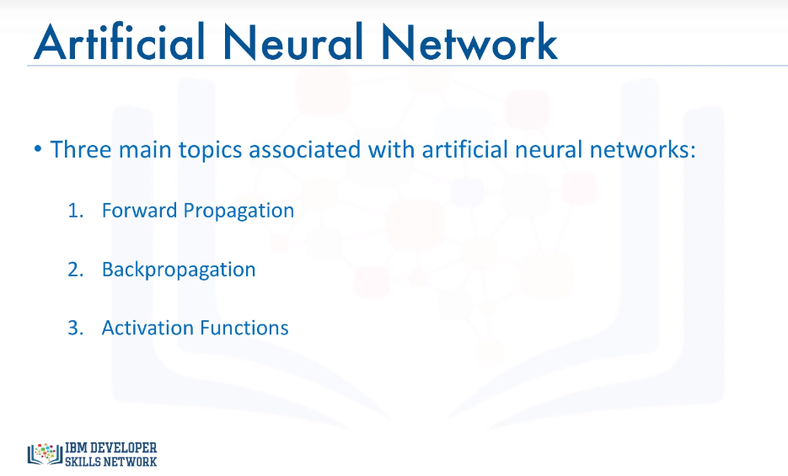

Slide 3
Forward Propagation
Forward propagation is the process through which data passes through layers of neurons in a neural network from the input layer all the way to the output layer.
A popular function is the sigmoid function, where if the weighted sum is a very large positive number, then the output of the neuron is close to 1, and if the weighted sum is a very large negative number, then the output of the neuron is close to zero.
Non-linear transformations like the sigmoid function are called activation functions.
Activation functions are another extremely important feature of artificial neural networks.
They basically decide whether a neuron should be activated or not. In other words, whether the information that the neuron is receiving is relevant or should be ignored.

Slide 4
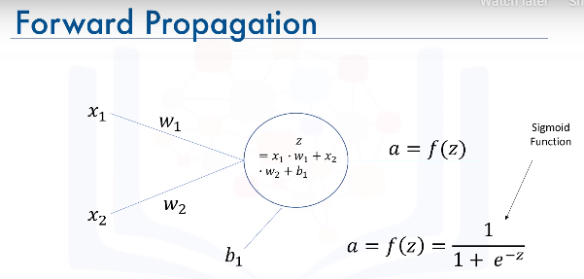

Slide 5
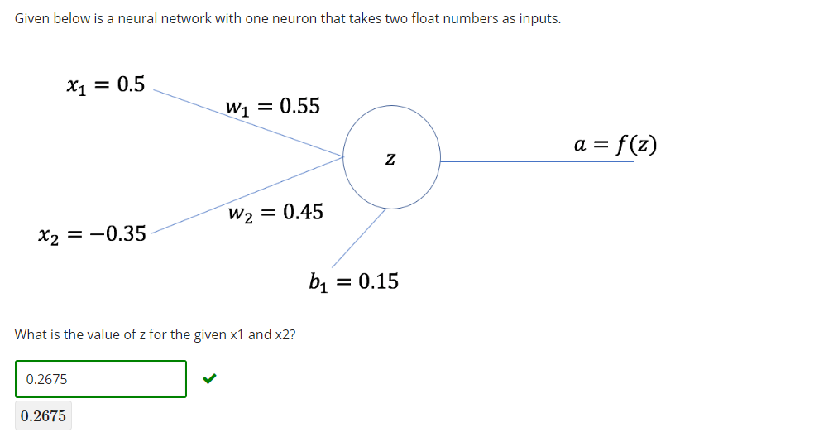
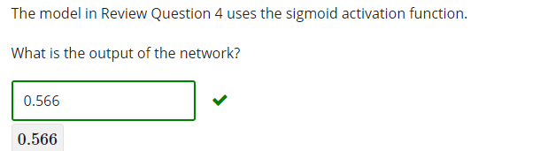

Slide 6
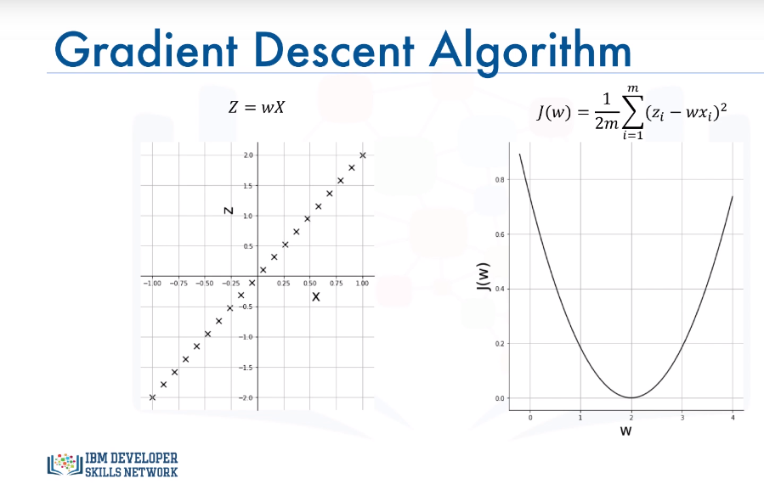
Gradient Descent
Gradient descent is an iterative optimization algorithm for finding the minimum of a function.

Slide 7
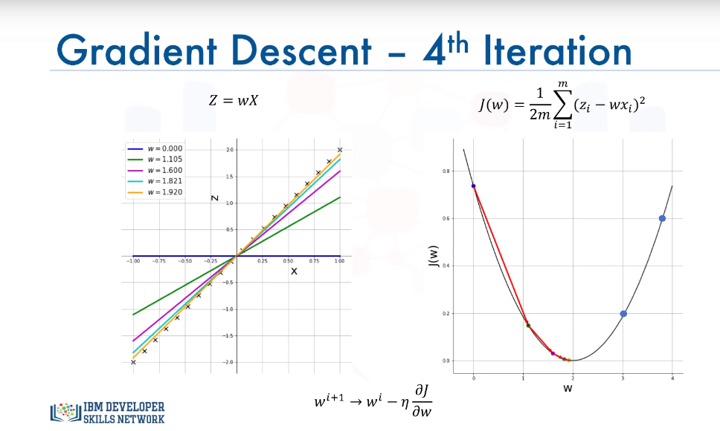
Example

Slide 8
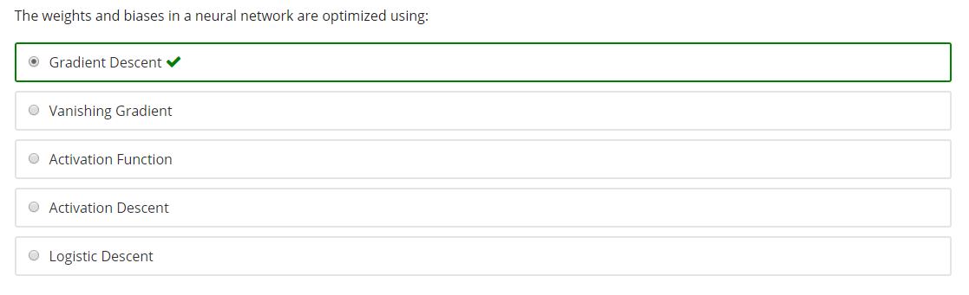
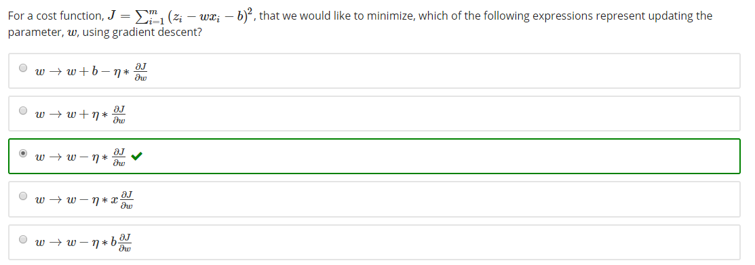

Slide 9
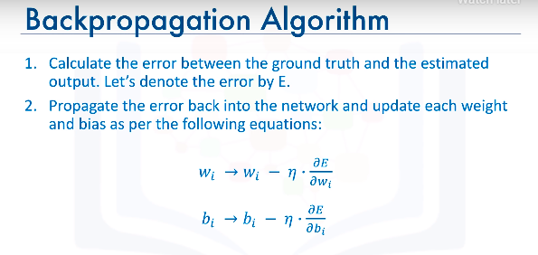
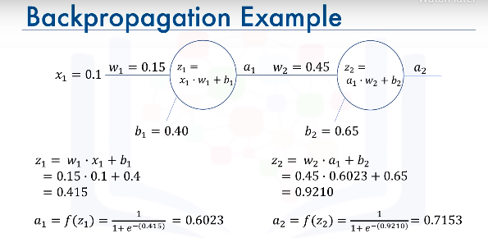

Slide 10
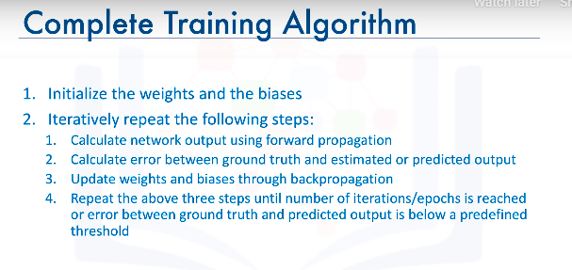

Slide 11
Vanishing Gradient
See how small the gradients are in the previous example , but more importantly, how small the gradient of the error with respect to w1. Well it turns out that because we are using the sigmoid function as the activation function, then all the intermediate values in the network are between 0 and 1.
So when we do backpropagation, we keep multiplying factors that are less than 1 by each other, and so their gradients tend to get smaller and smaller as we keep on moving backward in the network.
This means that the neurons in the earlier layers learn very slowly as compared to the neurons in the later layers in the network. The earlier layers in the network are the slowest to train.
The result is a training process that takes too long and a prediction accuracy that is compromised.
Accordingly, this is the reason why we do not use the sigmoid function or similar functions as activation functions, since they are prone to the vanishing gradient problem.

Slide 12
Activation Function - 1
Activation functions play a major role in the learning process of a neural network.
There are seven types of activation functions that you can use when building a neural network.
There is the binary step function, the linear or identity function, there is the sigmoid or logistic function, there is the hyperbolic tangent, or tanh function, the rectified linear unit (ReLU) function, the leaky ReLU function, and the softmax function.

Slide 13
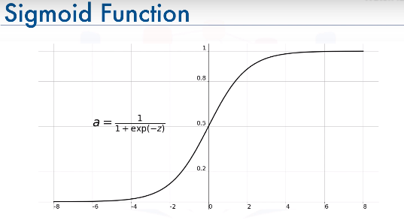
Activation Function - Sigmoid Function
Sigmoid function is widely used as activation function in the hidden la
However, as you can see, the function is pretty flat beyond the +3 and -3 region. This means that once the function falls in that region, the gradients become very small. This results in the vanishing gradient problem, and as the gradients approach 0, the network doesn't really learn.
Another problem with the sigmoid function is that the values only range from 0 to 1. This means that the sigmoid function is not symmetric around the origin.
The values received are all positive.
Well, not all the times would we desire that values going to the next neuron be all of the same sign.

Slide 14
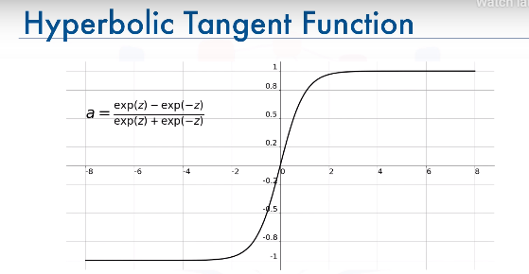
Activation Function – Hyperbolic Tangent Function
It is actually just a scaled version of the sigmoid function, but unlike the sigmoid function, it's symmetric over the origin.
It ranges from -1 to +1.
However, although it overcomes the lack of symmetry of the sigmoid function, it also leads to the vanishing gradient problem in very deep neural networks.

Slide 15
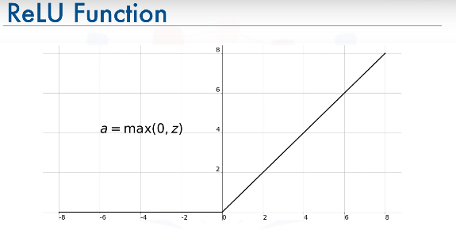
Activation Function – ReLU Function
The rectified linear unit, or ReLU, function is the most widely used activation function when designing networks today.
In addition to it being nonlinear, the main advantage of using the ReLU, function over the other activation functions is that it does not activate all the neurons at the same time.
According to the plot here, if the input is negative it will be converted to 0, and the neuron does not get activated.
This means that at a time, only a few neurons are activated, making the network sparse and very efficient.
Also, the ReLU function was one of the main advancements in the field of deep learning that led to overcoming the vanishing gradient problem.

Slide 16
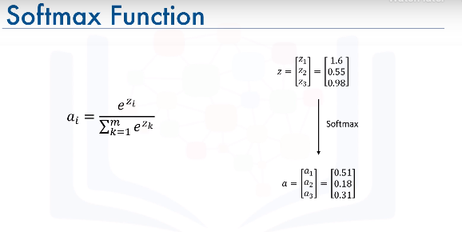
Activation Function – Softmax Function
The softmax function is also a type of a sigmoid function, but it is handy when we are trying to handle classification problems.
The softmax function is ideally used in the output layer of the classifier where we are actually trying to get the probabilities to define the class of each input.
So, if a network with 3 neurons in the output layer outputs [1.6, 0.55, 0.98] then with a softmax activation function, the outputs get converted to [0.51, 0.18, 0.31].
This way, it is easier for us to classify a given data point and determine to which category it belongs.

Slide 17
Activation Function - 2
The sigmoid and hyperbolic tangent functions are avoided in many applications nowadays due to the vanishing gradient problem.
The ReLU function is a general activation function and is used in most cases these days.
Note that ReLU function should only be used in hidden layers.
Generally, you can begin with using the ReLU activation function and then switch to other activation functions in case ReLU doesn’t yield optimum results.

Slide 18
Deep Learning Libraries
Tensorflow
Keras
PyTorch
Theano -> no Longer supported

Slide 19
Keras vs Pytorch vs Tensorflow
Tensorflow is the most popular deep learning library, developed by Google.
Pytorch is a cousin of the Lua-based Torch framework, and is a strong competitor to Tensorflow.
Keras is the easiest API to use and the go-to library for quick prototyping and fast development.

Slide 20
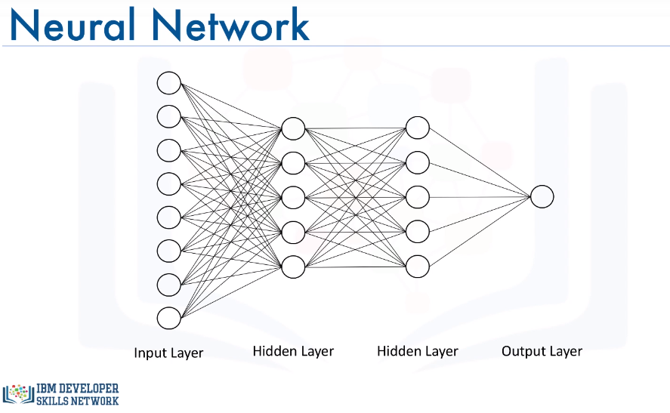
Regression Models with Keras – Example - 1

Slide 21
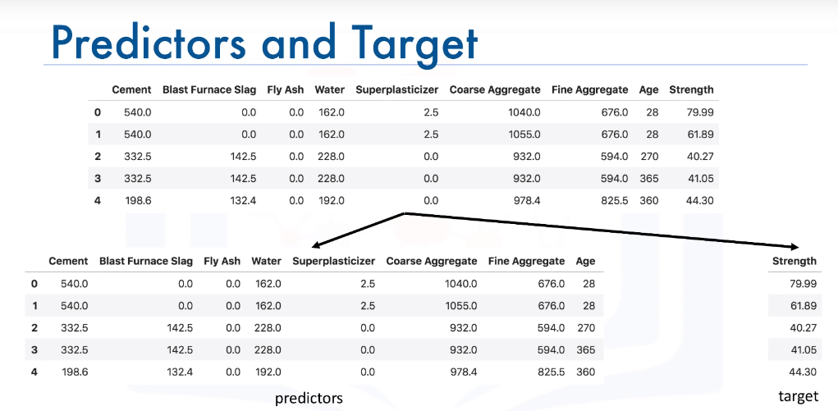
Regression Models with Keras – Example - 1
Such a network is called a dense network.
Before we begin using the Keras library, let's prepare our data and have it in the right format.
The only thing we would need to do is to split the dataframe into two dataframes, one that has the predictors columns and another one that has the target column. We will also name them predictors and target.
There are two models in the Keras library.
One of them is the Sequential model and the other one is the model class used with the functional API.
So to create your model, you simply call the Sequential constructor.

Slide 22
Keras code -1
First, we would need to import the "Dense“ type of layers from "keras.layers".
Then we use the add method to add each dense layer. We specify the number of neurons in each layer and the activation function that we want to use.
Functions, ReLU is one of the recommended activation functions for hidden layers, so we will use that.
And for the first hidden layer we need to pass in the "input_shape" parameter, which is the number of columns or predictors in our dataset.
Then we repeat the same thing for the other hidden layer, of course without the input_shape parameter, and we create our output layer with one node.
Now for training, we need to define an optimizer and the error metric. In the previous module, we used gradient descent as our minimization or optimization algorithm, and the mean squared error as our loss measure between the predicted value and the ground truth.
So we will stick with that and use the mean squared error as our loss measure.

Slide 23
Keras code -2
As for the minimization algorithm, there are actually other more efficient algorithms than the gradient descent for deep learning applications. One of them is "adam".
One of the main advantages of the "adam“ optimizer is that you don't need to specify the learning rate that we saw in the gradient descent video.
So this saves us the task of optimizing the learning rate for our model.
Then we use the fit method to train our model.
Once training is complete, we can start making predictions using the predict method.

Slide 24
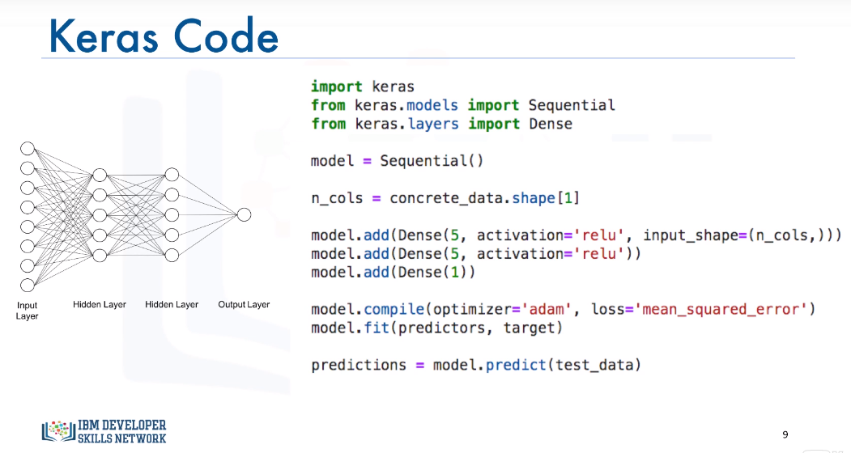

Slide 25
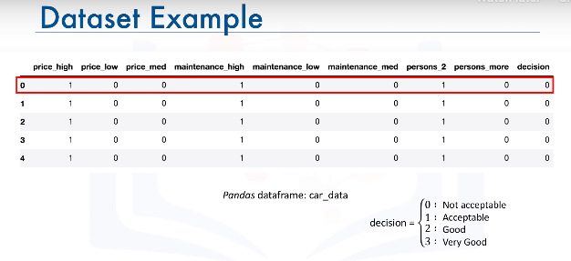
Classification Models with Keras - 1

Slide 26
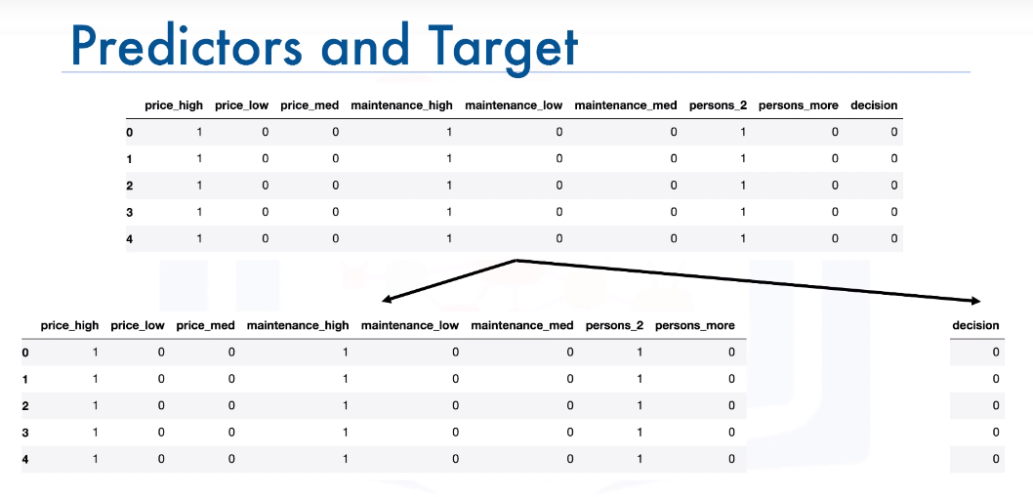
Classification Models with Keras - 2

Slide 27
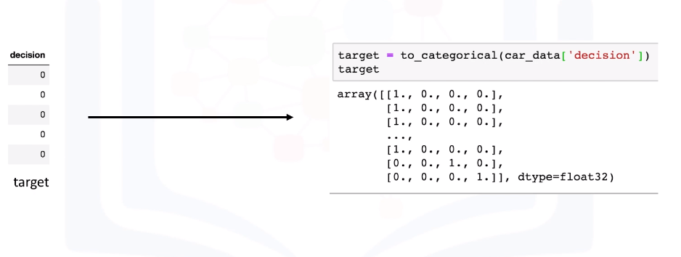
Classification Models with Keras - 3
For classification problems, we can't use the target column as is; we actually need to transform the column into an array with binary values similar to one-hot encoding like the output shown here.
We easily achieve that using the "to_categorical“ function from the Keras utilities package.
In other words, our model instead of having just one neuron in the output layer, it would have four neurons, since our target variable consists of four categories.

Slide 28
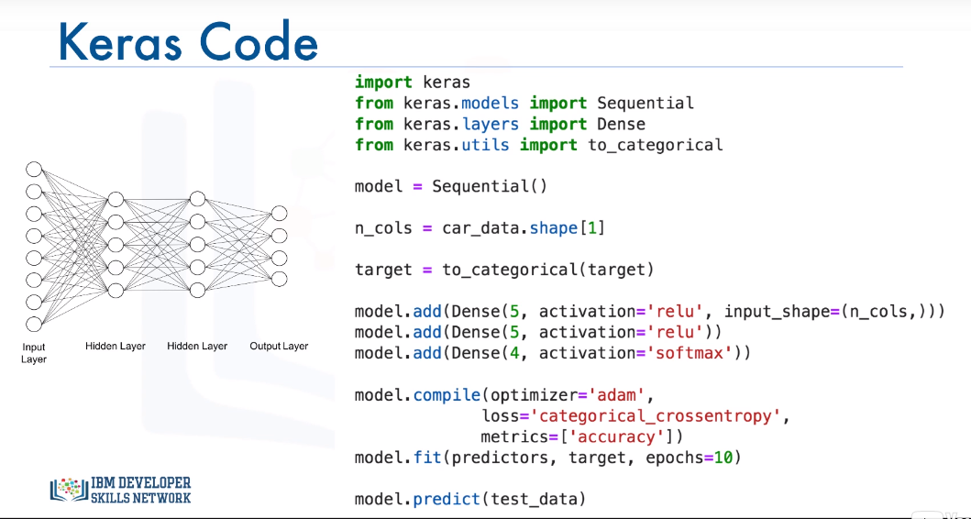

Slide 29
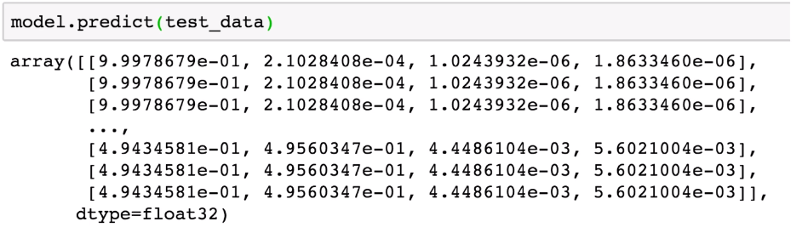
For each data point, the output is the probability that the decision of purchasing a given car belongs to one of the four classes.
For each data point, the probabilities should sum to 1, and the higher the probability the more confident is the algorithm that a datapoint belongs to the respective class.
So for the first data point or the first car in the test set, the decision would be 0 meaning not acceptable, since the first probability is the highest, with a value of 0.99 or close to 1, in this case.
Similarly, for the second datapoint, the decision is also 0 or not acceptable, since the probability for this class is the highest, again with a value of 0.99 or almost 1.
For the first three datapoints, the model is very confident that purchasing these cars is not acceptable.
As for the last three datapoints, the decision would be 1 or acceptable, since the probabilities for the second class are higher than the rest of the classes.
But notice how the probabilities for decision 0 and decision 1 are very close. Therefore, the model is not very confident but it would lean towards accepting purchasing these cars.

Slide 30
Keras code - Explanation
We start by importing the Keras library and the Sequential model and we use it to construct our model.
We also import the "Dense" layer since we will be using it to build our network.
The additional import statement here is the "to_categorical" function in order to transform our target column into an array of binary numbers for classification.
Then, we proceed to constructing our layers.
We use the add method to create two hidden layers, each with five neurons and the neurons are activated using the ReLU activation function.
Notice how here we also specify the softmax function as the activation function for the output layer, so that the sum of the predicted values from all the neurons in the output layer sum nicely to 1.
Then in defining our compiler, here we will use the categorical cross-entropy as our loss measure instead of the mean squared error that we use for regression, and we will specify the evaluation metric to be "accuracy". "accuracy" is a built-in evaluation metric in Keras but you can actually define your own evaluation metric and pass it in the metrics parameter.
Then we fit the model.
Notice how this time we're specifying the number of epochs for training the model. Although we didn't specify the number of epochs when we built a regression model, but we could have done that.
Finally, we use the predict method to make predictions.

Slide 31
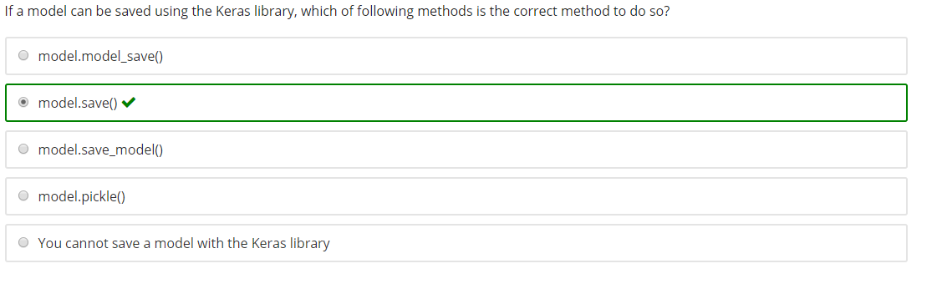

Slide 32
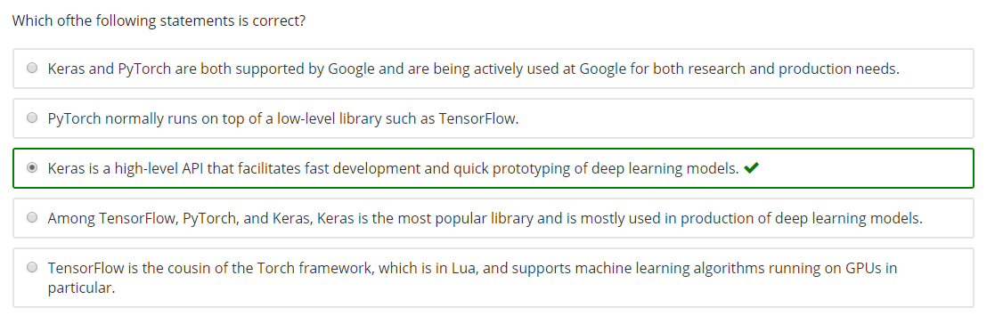
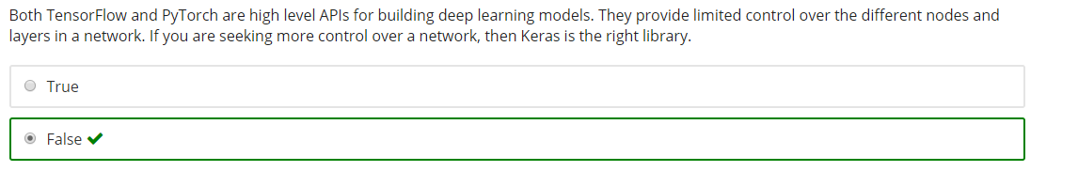

Slide 33
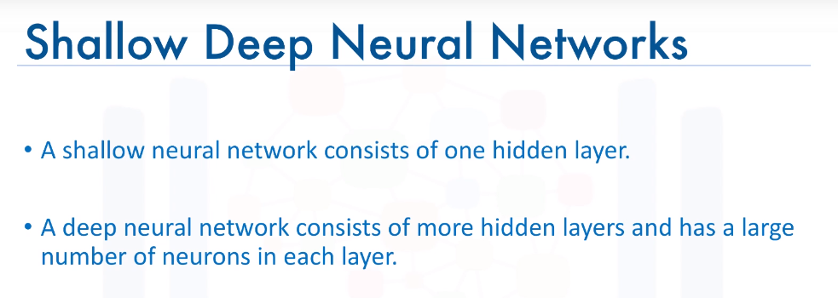
Shallow vs Deep Neural Networks – 1

Slide 34
Shallow vs Deep Neural Networks – 2
Therefore, advancement in the field itself is one factor that helped deep learning take off.
Another main reason is the availability of data.
Deep neural networks work best when trained with large amounts of data, since neural networks learn the training data so well, then large amounts of data have to be used in order to avoid overfitting of the training data.
With NVIDIA's super powerful GPUs, we are now able to train very deep neural networks on tremendous amount of data in a matter of hours as opposed to days or weeks, which is how long it used to take to train very deep neural networks.
Therefore, users are able to experiment with different deep neural networks and test different prototypes in much shorter periods of time.

Slide 35
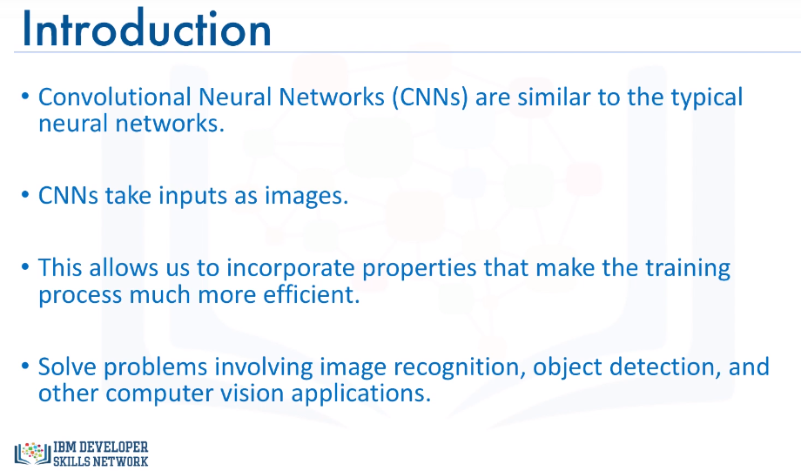
DL Algorithm – Convolutional Neural Network -1

Slide 36
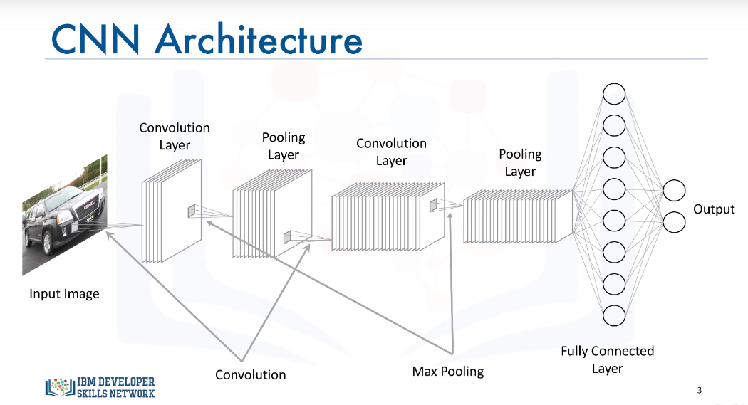
The input to a convolutional neural network, on the other hand, is mostly an (n x m x 1) for grayscale images or an (n x m x 3) for colored images, where the number 3 represents the red, green, and blue components of each pixel in the image.
In the convolutional layer, we basically define filters and we compute the convolution between the defined filters and each of the three images.

Slide 37
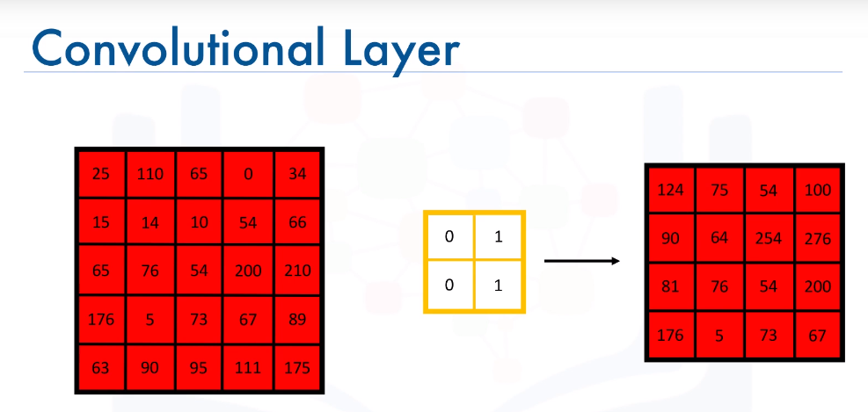
DL Algorithm – Convolutional Neural Network - 2

Slide 38
DL Algorithm – Convolutional Neural Network - 2
In the convolutional layer, we basically define filters and we compute the convolution between the defined filters and each of the three images. If we take the red image for example, let's assume these are the pixel values. Now for a (2 x 2) filter with these values, let's create an empty matrix to save the results of the convolution process.
We start by sliding the filter over the image and computing the dot product between the filter and the overlapping pixel values and storing the result in the empty matrix. We repeat this step moving our filter one cell, or one stride is the proper terminology, at a time, and we repeat this until we cover the entire image and fill the empty matrix.
Here, I just showed one filter and only one of the three images. The same thing would be applied to the green and blue images and you can apply more than one filter. The more filters we use, the more we are able to preserve the spatial dimensions better. But one question you must be asking yourself at this point is, why would we need to use convolution? Why not flatten the input image into an (n x m) x 1 vector and use that as our input?
Well, if we do that, we will end up with a massive number of parameters that wil need to be optimized, and it will be super computationally expensive. Also, decreasing the number of parameters would definitely help in preventing the model from overfitting the training data.
It is worth mentioning that a convolutional layer also consists of ReLU's which filter the output of the convolutional step passing only positive values and turning any negative values to 0.

Slide 39
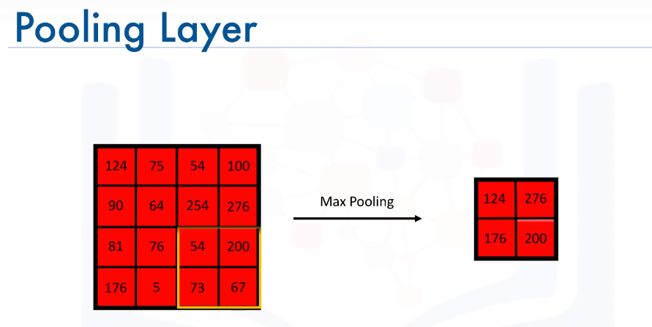
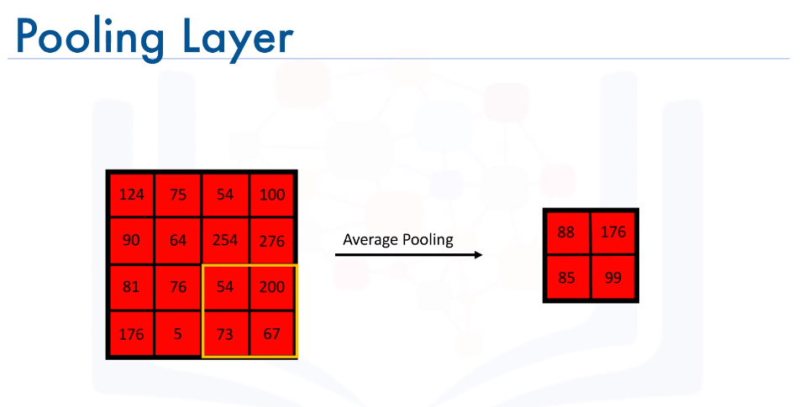
DL Algorithm – Convolutional Neural Network - 3
The pooling layer's main objective is to reduce the spatial dimensions of the data propagating through the network. There are two types of pooling that are widely used in convolutional neural networks. Max- pooling and average pooling.
In max-pooling which is the most common of the two, for each section of the image we scan we keep the highest value, like so.
Here our filter is moving two strides at a time.
Similarly, with average pooling, we compute the average of each area we scan.
In addition to reducing the dimension of the data, pooling, or max pooling in particular, provides spatial variance which enables the neural network to recognize objects in an image even if the object does not exactly resemble the original object.

Slide 40
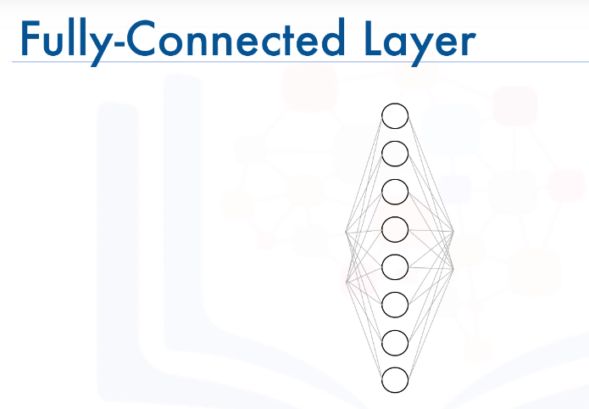
Finally, in the fully connected layer, we flatten the output of the last convolutional layer and connect every node of the current layer with every other node of the next layer.
This layer basically takes as input the output from the preceding layer, whether it is a convolutional layer, ReLU, or pooling layer, and outputs an n-dimensional vector, where n is the number of classes pertaining to the problem at hand.

Slide 41
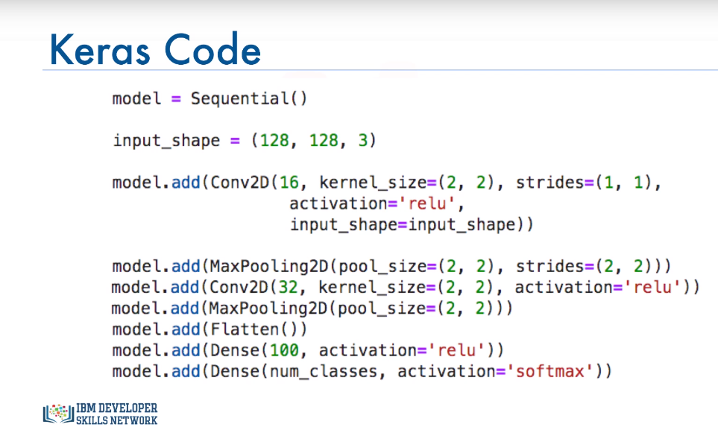

Slide 42
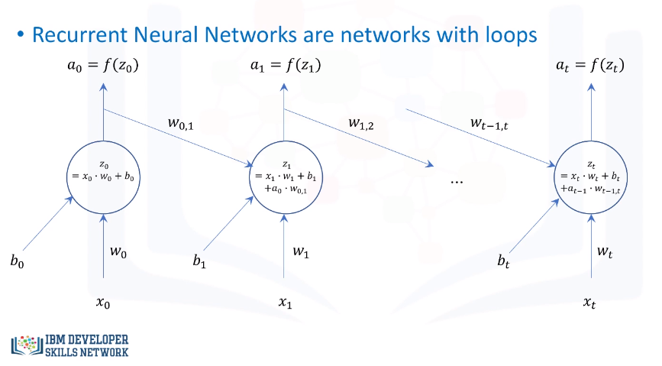
Recurrent Neural Network - 1

Slide 43
Recurrent Neural Network - 2
It’s a supervised deep learning model.
RNNs for short, are networks with loops that don't just take a new input at a time, but also take in as input the output from the previous data point that was fed into the network.
A very popular type of recurrent neural network is the long short-term memory model or the (LSTM) model for short. It has been successfully used for many applications including image generation, where a model trained on many images is used to generate new novel images.
Another application is handwriting generation, which I described in the welcome video of this course.
Also LSTM models have been successfully used to build algorithms that can automatically describe images as well as streams of videos.

Slide 44
Autoencoders – 1
Autoencoding is a data compression algorithm where the compression and the decompression functions are learned automatically from data instead of being engineered by a human.
Such autoencoders are built using neural networks. Autoencoders are data specific, which means that they will only be able to compress data similar to what they have been trained on.
Therefore, an autoencoder trained on pictures of cars would do a rather poor job of compressing pictures of buildings, because the features it would learn would be vehicle or car specific.
Some interesting applications of autoencoders are data denoising and dimensionality reduction for data visualization.

Slide 45
Autoencoders – 2
An autoencoder is an unsupervised neural network model. It uses backpropagation by setting the target variable to be the same as the input. In other words, it tries to learn an approximation of an identity function.
Because of non-linear activation functions in neural networks, autoencoders can learn data projections that are more interesting than a principal component analysis PCA or other basic techniques, which can handle only linear transformations.
A very popular type of autoencoders is the Restricted Boltzmann Machines or (RBMs) for short.
RBMs have been successfully used for various applications, including fixing imbalanced datasets. Because RBMs learn the input in order to be able to regenerate it, then they can learn the distribution of the minority class in an imbalance dataset ,and then generate more data points of that class, transforming the imbalance dataset into a balanced data set.
Similarly, RBMs can also be used to estimate missing values in different features of a data set. Another popular application of Restricted Boltzmann Machines is automatic feature extraction of especially unstructured data.

Slide 46
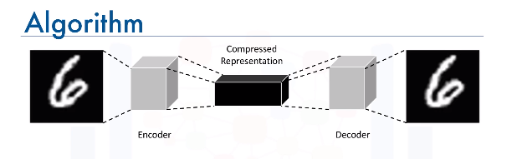
Autoencoder – Architecture

Slide 47
